Slide 1
Counting

Slide 2
Refreshing on Set Cardinality
Adding set cardinalities - intersection
A = {1, 2, 3, 4}
B = {a, b, c, d}
|A ∪ B|
{1, 2, 3, 4, a, b, c, d}
|A| + |B| = 8
Does this always work
At least with union?
| A U B | = |A| + |B| ONLY when sets are disjoint
A = {1, 2, 3, 4} B = {1, 2, 5, 8} | A U B | = 9

Slide 3
Inclusion Exclusion principle
Lets look at a practical example…
I want you to tell me the number 6-letter of words in the dictionary that start with “A” or end with “Z” (or both)
Or – more precisely I want a formula to determine how I could count this
How could we frame this as a set operation
A = set of all 6- letter words that start with A
B = set of all 6 letter words that end with Z
| A U B| = |A| + |B| - | A ∩ B |

Slide 4
Now you try
A = {1, 2, 3, 4}
B = {8, 2, 1, 6, 7}
C = {4, 1, 9, 12, 13}
D = {8, 3, 9, 1, 17}
What is | A U B U C U D | ?

Slide 5
Counting Cartesian Products
I want to order a pizza
This pizza site is very limited
My options
Size:
Small
Medium
Large
XL
Toppings
Pepperoni
Sausage
Veggie
Anchovies
Pineapple
How many 1 topping pizzas can I potentially order
(small pepperoni != large pepperoni)
Size = {sm, med, lg, xl}
Toppings = {pep, sau, veg, anch, pin}
|Size x Toppings|
|Size x Toppings| = |Size| * |Toppings|

Slide 6
Another example
Personal Identification Numbers (PINs) are always 6-digit numbers containing only the digits 0-9
(Or at least for the purpose of this problem they are)
How many possible 6-digit pins are there?
Explain using set theory
A = {0, 1,..., 9}
|A| = 10
|A x A x A x A x A x A| = 10⁶

Slide 7
A more complex one
Get into groups of at least 2
Or I can do it for you
Go to Chipotle’s website for online ordering
Assuming that you could only pick 1 from each category, how many different types of burrito can you make?

Slide 8

Together:
Lock takes a 6-letter combination to open
How many potential combinations are there that EITHER
Start with “A”
End with “Z”

Slide 9
Applying this logic again
Personal Identification Numbers (PINs) are always 6-digit numbers containing only the digits 0-9
(Or at least for the purpose of this problem they are)
How many possible 6-digit pins are there?
Explain using set theory
A = {0, 1,..., 9}
|A| = 10
|A x A x A x A x A x A| = 10⁶

Slide 10
How many combos start with A
Any 1 slot can have 26 potential inputs
1 * 26 * 26 * 26 * 26 * 26
|starts with A | = 26^5
26 potential things here
A
A-Z
A-Z
A-Z
A-Z
A-Z
1 potential thing can go here

Slide 11
Same for Z
Same number of slots
Same number of choices per slot
|ends with Z| = 26^5
A-Z
A-Z
A-Z
A-Z
A-Z
Z

Slide 12
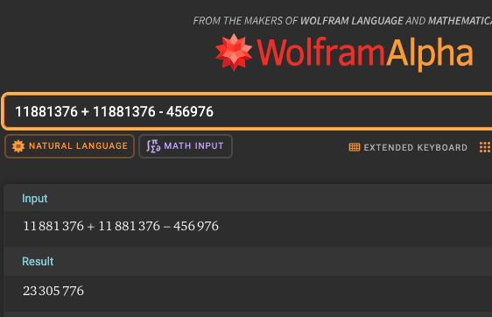
Inclusion Exclusion again
|A U Z| = |A| + |Z| - |A ∩ Z|
|A ∩ Z|
1 * 26 * 26 * 26 * 26 * 1
1 * 26⁴ * 1
|A U Z| = |A| + |Z| - |A ∩ Z|
|A U Z| = 26⁵ + 26⁵ - 26⁴

Slide 13
Combinitorics
Math considering the world of possible configurations, combinations or permutations

Slide 14
Lets start with counting groupings where order matters

Slide 15
Practice
I have five errands to run. How many ways could I accomplish these 5 tasks?
grocery shopping
visit the bank
drop off library books
drop off mail
pick up pet food.
S = set of tasks
n = |S| Number of permutations of a set is n!

Slide 16
Quick refresher!
Factorial!
5! = 5 * 4 * 3 * 2 * 1 = 120
N! = n * n-1 * … * 1
0! = 1
Essentially, there is exactly 1 way to order 0 items

Slide 17
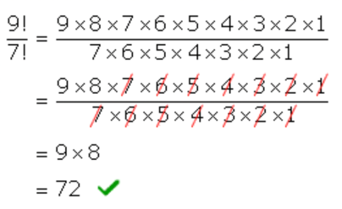
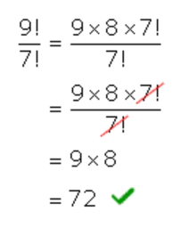
Factorials in fractions – save yourself some work if possible

Slide 18
So For my chore list of 5 tasks
S = {grocery, bank, library, mail, pet store}
|S| = 5
Number of permutations = 5!

Slide 19
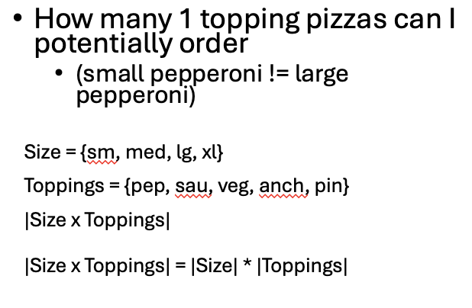
But
What if I only have time for 2 chores?
How many ordered arrangements could I have here?
2_chore = {(x, y) | (x,y) ∈ SxS}
2 “slots”
5 options for slot 1
4 options for slot 2
Going to the bank twice isn’t an option

Slide 20
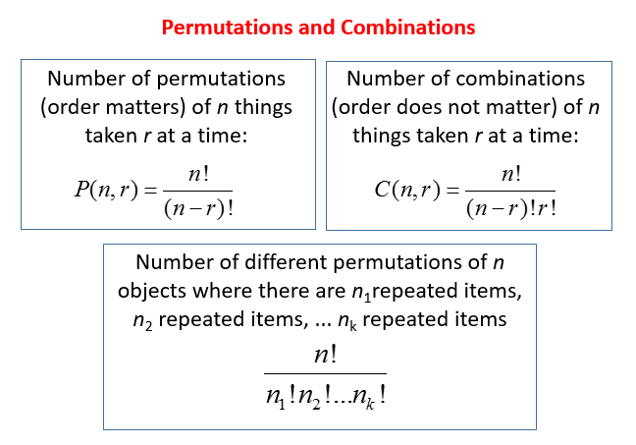
What about if I have time for 3 chores? Or some other number?
This is something called an r-permutation.
Denoted nPr.
n is the number of distinct elements
(aka the cardinality of the set in question)
r = the number of things I can pick

Slide 21
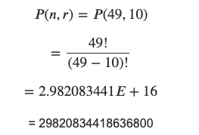
Some quick examples
I have 8 grocery items on my list, how many ways can I go get them?
n = r = 8
8! / 0!
Remember 0! = 1
40320
There are 49 rides at Disneyland, I have time to wait in line for 10 of them
How many different orders could I tackle?

Slide 22
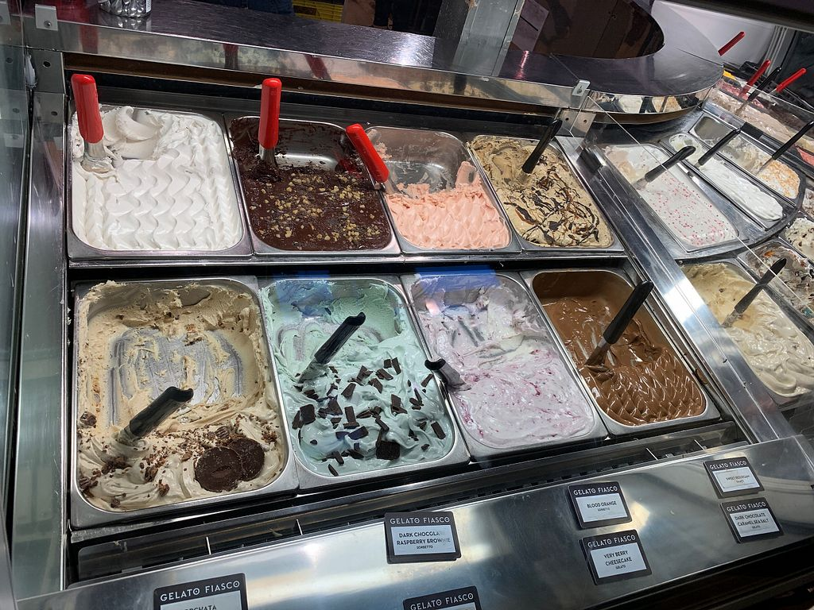
What if order doesn’t matter?
There are 25 flavors of gelato at Gelato Fiasco*
I want a dish with 2 flavors in it
How many possible orders could I make
Chocolate and hazelnut is the same as hazelnut and chocolate
Combinations
* For the purposes of this problem

Slide 23

Combinations
Used to count possible groupings when order within the set doesn’t matter
When n and r are not equivalent this can be called an r-combination
Aka nCr
Or
Also can be called “n choose r”

Slide 24
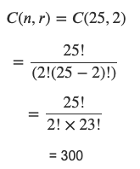
Gelato though:
25 flavors
I want a dish with 2
25 choose 2

Slide 25
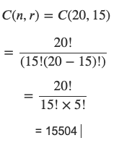
Quick practice on your own
Tickets for a concert are given out randomly to a class containing 20 students. No student is given more than one ticket. There are 15 tickets.
Find the number of ways in which the tickets can be distributed

Slide 26
Using the formula should be pretty straightforward It’s figuring out how to apply it that can be hard
Let A = {1, 2, 3, 4, 5, 6, 7, 8, 9}
How many 5-element subsets of A have exactly two even elements?
Discussion: how would you think to go about calculating this?

Slide 27
My approach:
Identify all combinations of 2 even numbers possible
4 even numbers {2, 4, 6, 8}
4C2 = 6
4! / 2! * (4-2)! = (4 * 3) / 2 = 12/ 2 = 6
That leaves us with 3 “slots” to fill with odd numbers
Remember- exactly 2 need to be even
5 odd numbers, 3 slots = 5C3 = 10
5! / 3! * 2! = 5 * 4 / 2 * 1 = 20 / 2 = 10
B = set of our 2-item combos
C = set of our 3-item combos BxC = all combos so |BxC| = all possible sets |BxC| = |B| * |C| so I get 60 possible sets

Slide 28
More Practice
A plant nursery sells 10 different varieties of rose bush
A gardener wishes to buy 6 rose bushes, all different varieties
How many ways she can make her selection?
1. Which formula to use here? 2. What’s the answer?

Slide 29
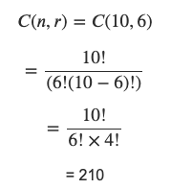
Order doesn’t matter here: Combinations
N = 10 possible rose bushes
R = 6 possible “slots” in our cart
10 * 9 * 8 * 7
--------------- 4 * 3 * 2 * 1
5040 / 24

Slide 30
nPr common less other common nomenclature
nCr Commonly: “n choose r”
https://www.onlinemathlearning.com/igcse-permutations-combinations.html

Slide 31
Counting with repetition
When order matters?
We already did this!
Cartesian Product cardinality!
How many 6-digit PINs are there?
A = { n | n ∈ N, 0 ≤ n < 10}, |A| = 10
| A x A x A x A x A x A | = 10⁶
When order DOESN’T matter….

Slide 32
When order doesn’t matter
You have 5 coins in your pocket
You’re not sure which coins you have but they’re in US currency
So denominations of 1, 5, 10, and 25 cents
Could be all the same, could be all unique, or something in-between….
[1,1,1,1,1], [1,1,1,1,5], [1,1,1,1,10], [1,1,1,25], [1,1,1,5,5], etc
* Brackets here in math indicate a multiset aka A set that allows for repetition

Slide 33
Lets phrase this another way: A “stars and bars” problem
[1, 1, 1, 5, 10] = [* * * | * | * |] = 3 1s, 1 5, 1 10
[1, 1, 10, 25, 25] = [* * | | * | * *]
[5, 5, 25, 25, 25] = [| * * | | * * *]
We can show how many of each type by delineating with |
Works out when we have an inherent ordering
Notes:
How many bitstrings of length 8 have 3 1s?
We’re picking indicies and those are combinations, not permutations
Slow it down
Ask them to determine another diagram to encourage them getting the symbolism here
Maybe wait until after lists next time?
How many combinations of indices can we work?
Either 3 spots for the bars or 5 spots for the stars (either way we’re doing 8C3 or 8C5 and those end up being the same thing)

Slide 34
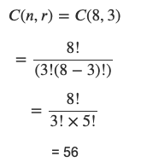
Why phrase another way though?
Instead of thinking of all of the possible combinations, we can now make this an easier combinations problem
There will always be 3 “|”s to separate how many of each group of coins
There will always be 5 ”*” to indicate coins
This formulation requires a set of 8 ”slots”
(for either a * or a |)
So: our question becomes, how many different places among those 8 slots, can we put the bars
8 total “slots” where things can go
3 must be bars

Slide 35
Stars and Bars (aka “balls and bins” problems)
A computer has 5 tasks it needs to run
All 5 tasks take the same amount of time and resources to run
The computer’s CPU has 4 cores
A core can receive any number of tasks (0 – all 5)
How many different ways can a computer allocate these 5 tasks to these 4 cores?
Same thing: Core 1: 2 tasks, Core 2: 1 task Core 3: 0 tasks, Core 4: 2 tasks
[* * | * | | * * ]

Slide 36
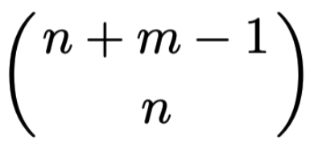
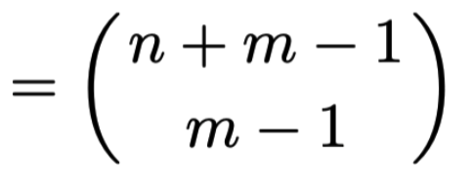
Generally speaking
The number of n-element multisets that can be created from a set with m values is…
Which is n + m-1 choose n
n + m-1 choose m-1

Slide 37
Try some more
How many combinations of 4 letters (A-Z) can you make with repetition?
How many ways can you place 20 identical balls into 5 different boxes?
A challenge problem:
A bag contains 20 identical red balls, 20 identical blue balls, 20 identical green balls, and exactly 1 white ball.
You reach in and grab 20 balls.
How many different outcomes are possible?
29 C 4 = 23,751
24 C 5 = 42,504

Slide 38
Challenge answer
2 categories of outcome
Yes white ball
No white ball
No white ball (3 colors)
20 + (3-1) choose 3-1
22 C 2 = 231
= 22 C 20
Yes white ball – 1 slot taken
We just need to figure out all the possible combinations of the other 19 balls
19 slots 3 colors
19 + (3-1) choose 3-1 = 21 choose 2 = 210

Slide 39
Binomials

Slide 40
What does Binomial mean
You’ve probably heard the term “polynomial” back in algebra
Math expression
Poly – many
Nomial – terms
Ex. 2a + 3b – c
Many variables
Bi – 2
Exactly 2 variables
b²– 3c
2a / 5p

Slide 41
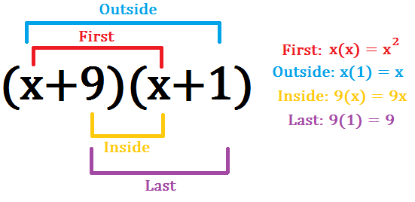
Quick refresher on multiplying polynomials
Sometimes called FOIL
(x + 9)(x + 1) = x² + x + 9x + 9

Slide 42
Weird patterns emerge as we expand a binomial…
(a + b)¹ = (a + b)
(a + b)² = a² + 2ab + b²
(a + b)³ = a³ + 3a²b + 3ab² + b³
(a + b)⁴ = a⁴ + 4a³b + 6a²b² + 4ab³ + b⁴
(a + b)⁵ = a⁵ + 5a⁴b + 10a³b² + 10a²b³ + 5ab⁴ + b⁵

Slide 43


Weird observation 1: exponents for a and b
Exponents on “a” decrease from left to right
“b” similarly increases from left to right

Slide 44
Weird observation 2: number of terms
(a + b)¹ = (a + b)
(a + b)² = a² + 2ab + b²
(a + b)³ = a³ + 3a²b + 3ab² + b³
(a + b)⁴ = a⁴ + 4a³b + 6a²b² + 4ab³ + b⁴
(a + b)⁵ = a⁵ + 5a⁴b + 10a³b² + 10a²b³ + 5ab⁴ + b⁵
← 3 terms
← 4 terms
← 5 terms
← 6 terms
(a + b)^{n} would have n+1 terms

Slide 45
Weird observation 3: Coefficients
(a + b)¹ = (1a + 1b)
(a + b)² = 1a² + 2ab + 1b²
(a + b)³ = 1a³ + 3a²b + 3ab² + 1b³
(a + b)⁴ = 1a⁴ + 4a³b + 6a²b² + 4ab³ + 1b⁴
(a + b)⁵ = 1a⁵ + 5a⁴b + 10a³b² + 10a²b³ + 5ab⁴ + 1b⁵

Slide 46
Weird observation 3: Coefficients
(a + b)¹ = 1a + 1b
(a + b)² = 1a² + 2ab + 1b²
(a + b)³ = 1a³ + 3a²b + 3ab² + 1b³
(a + b)⁴ = 1a⁴ + 4a³b + 6a²b² + 4ab³ + 1b⁴
(a + b)⁵ = 1a⁵ + 5a⁴b + 10a³b² + 10a²b³ + 5ab⁴ + 1b⁵

Slide 47
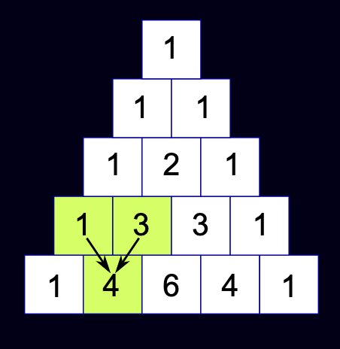
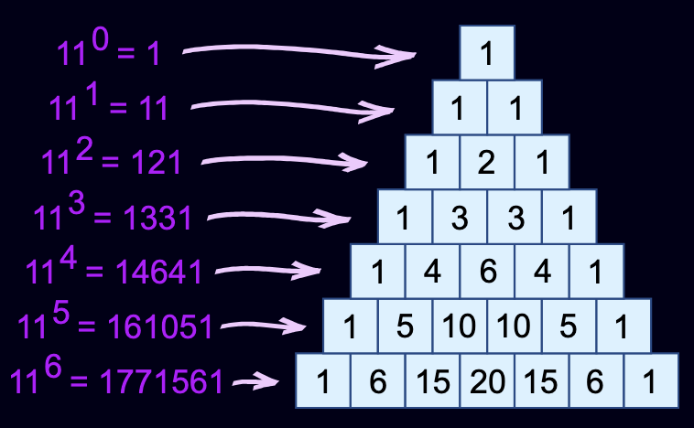
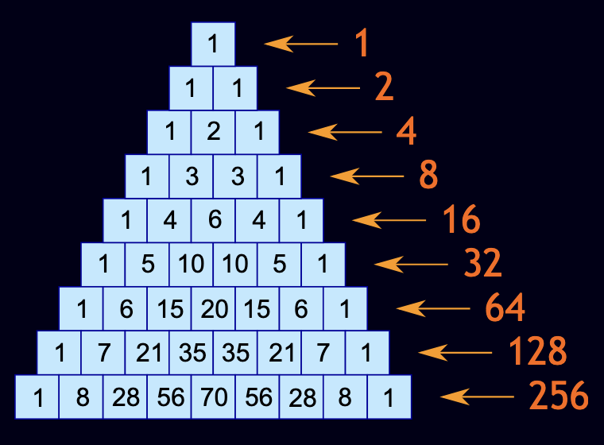
Pascal’s Triangle

Slide 48
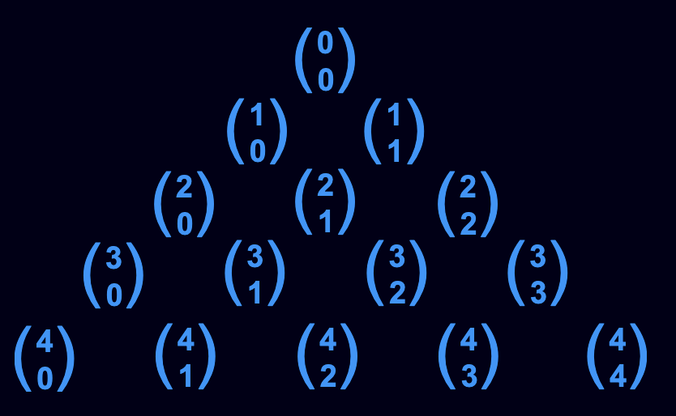
A formula for calculating any row of pascal’s triangle
Combinations!
0C0
1C0
1C1

Slide 49
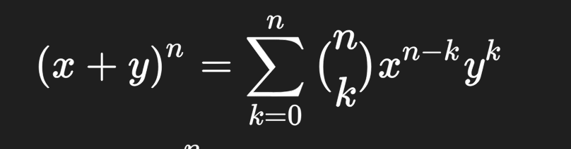
So that’s neat
Don’t worry we’ll unpack it

Slide 50
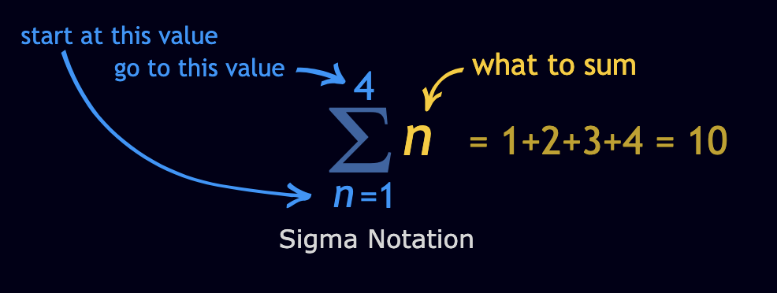
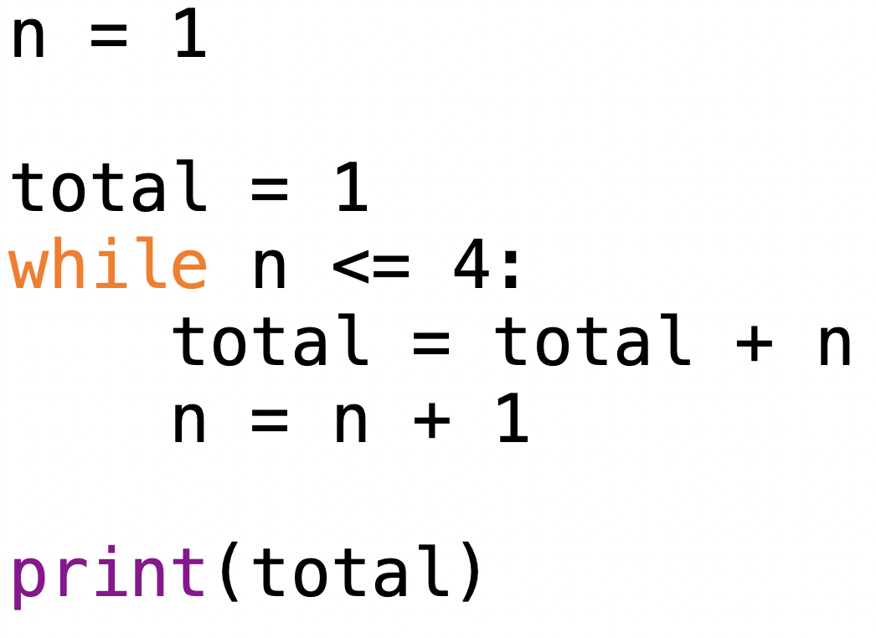
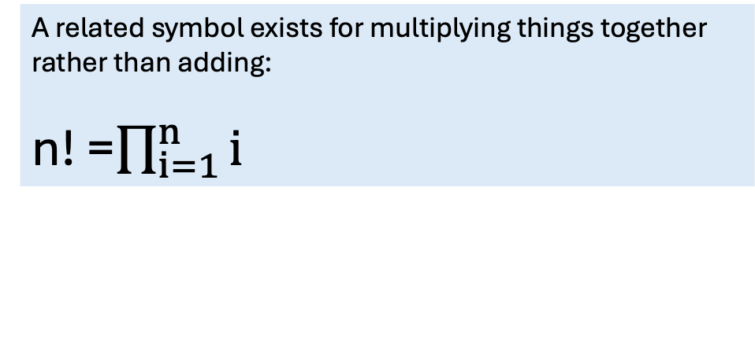
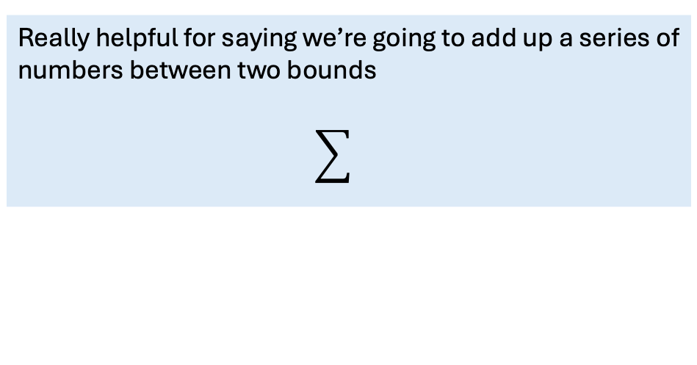
Sigma notation
Really helpful for saying we’re going to add up a series of numbers between two bounds
← Current 5001-ers this is next week’s material
A related symbol exists for multiplying things together rather than adding: n! =$\prod_{i=1}^{n}{i}$

Slide 51
In our case
Adding up n choose k times x ^{n-k} times y^{k}

Slide 52
(x + y)³ = …
(3 C 0) * x³ * y⁰
(3 C 1) * x² * y¹
(3 C 2) * x¹ * y²
(3 C 3) * x⁰ * y³
(x + y)³ = …
1 * x³ * y⁰
3 * x² * y¹
3 * x¹ * y²
1 * x⁰ * y³
x³y⁰ + 3x²y¹ + 3x¹y² + 1x⁰y³
+
+

Slide 53

Pigeons
https://blog.lauraerickson.com/2021/11/a-conversation-with-rosemary-mosco-part_01539348009.html

Slide 54
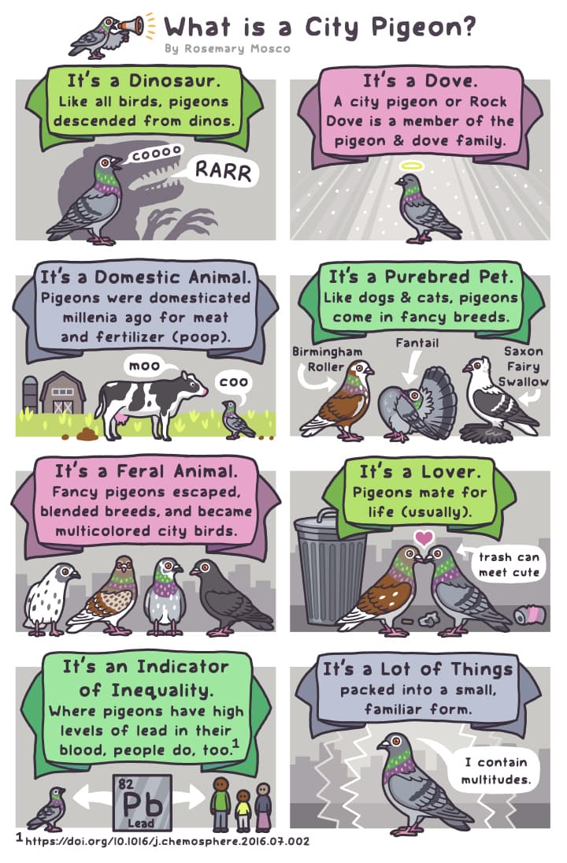
Pigeons and Counting
I have 5 buckets and 6 rocks
I put all of my rocks into buckets
What can I say about the contents of the buckets?
Don’t overthink here- these will feel obvious
Mandatory Pigeon Fact 1
https://rosemarymosco.com/comics/bird-and-moon/what-is-a-city-pigeon

Slide 55
Facts about buckets
At least 1 bucket has rocks in it
At least 1 bucket has more than one rock in it
Mandatory Pigeon Fact 2
https://rosemarymosco.com/comics/bird-and-moon/what-is-a-city-pigeon

Slide 56
This is what we call the pigeonhole principle
At least 1 bucket has rocks in it
At least 1 bucket has more than one rock in it
Mandatory Pigeon Fact 3
https://rosemarymosco.com/comics/bird-and-moon/what-is-a-city-pigeon

Slide 57
Flipping it around
I have 5 rocks and 7 buckets
At least 1 bucket has rocks in it
At least 1 bucket is empty
Mandatory Pigeon Fact 4
https://rosemarymosco.com/comics/bird-and-moon/what-is-a-city-pigeon

Slide 58
Generally…
If n objects are placed in k boxes, then there must exist a box that contains ⌈ N/k⌉ or more objects
⌈A⌉ - “ceiling”
smallest integer higher than A
⌊A⌋ - “floor”
largest integer lower than A
Think rounding up or down
even if we’re not quite rounding here
Mandatory Pigeon Fact 5
https://rosemarymosco.com/comics/bird-and-moon/what-is-a-city-pigeon

Slide 59
Example
Suppose that there are 51 students in a class. How many students are guaranteed to have a birthday in the same month?
⌈51 students / 12 months ⌉ = ⌈4.25⌉ = 5

Slide 60
Going to the movies
The New Village Cinema showed 6 different movies on Saturday night in 6 300-seat theaters
On Saturday exactly 111 people came to the theater
“I know that at least N people will view the same movie.”
What is the largest value N can have for that statement to necessarily be true?
What would N be if there were only 5 theaters open on Saturday (all different movies?)
⌈111 / 6⌉ = 19
⌈111 / 5⌉ = 23

Slide 61
Some more practice problems

Slide 62
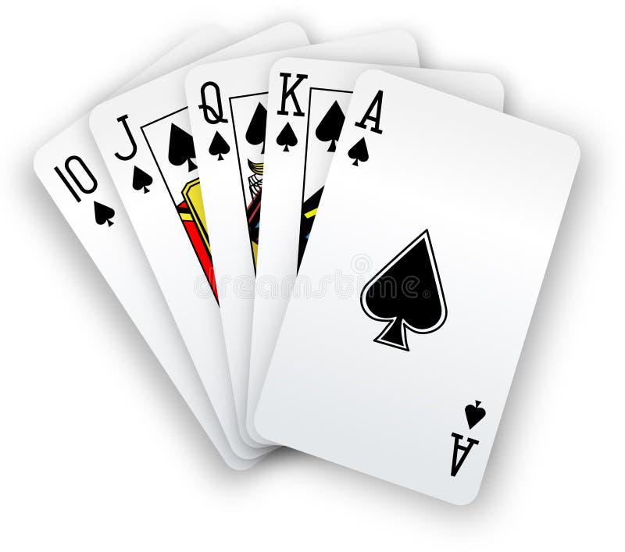
Combination or Permutation?
I’m drawing 5 cards from a shuffled deck
How many possible 5-card hands are there?
Combination – Order doesn’t matter

Slide 63
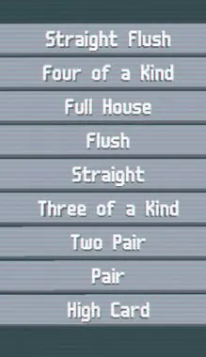
Going further: Try in groups
I want to know how many 5-card hands there are
Pick one poker hand higher than a 3 of a kind. How many possible versions of that hand are there in a deck of 52 cards
Work with at least one person
10,J,Q,K,A - all same suit
Any 4 of the same rank
Pair + 3 of a kind
All same suit, any rank
5 cards with consecutive rank
3 cards same rank
4 cards each of the same 2 ranks
2 cards same rank
Highest number at the table

Slide 64
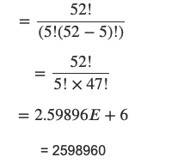
Number of possible 5-card hands
Combination with no repetition
52! / 5! * (52 – 5)!

Slide 65
Possible straights
{A, 2, 3, 4, 5}
{2, 3, 4, 5, 6}
{3, 4, 5, 6, 7}
{4, 5, 6, 7, 8}
{5, 6, 7, 8, 9}
{6, 7, 8, 9, 10}
{7, 8, 9, 10, J}
{8, 9, 10, J, Q}
{9, 10, J, Q, K}
{10, J, Q, K, A}
4 suits of cards
A,2,3,4, 5
(4 * 4 * 4 * 4 * 4) = 4⁵ = 1024
10 possible straights
10 * 1024 = 10,240

Slide 66
Passwords
How many passwords can be made using 4 lowercase letters?
What if we say 4 lower and uppercase letters?
What if exactly 1 character needs to be a punctuation mark
Lets say just these: S = {!, @, #, $, %, ^, &, *, (, ), ~, <, >, ?} |S| = 14

Slide 67
More passwords
Thinking the other way
I want to write a program that will just try every possible password to my NEU email
For the sake of sanity, we’ll say that a password needs to be between 6 and 21 characters
Lets start with exclusively lowercase letters
Each attempt my program makes takes 1/100th of a second
Assuming the program only gets it right on the last possible password attempt, how long will this program take?
USE. A. CALCULATOR

Slide 68
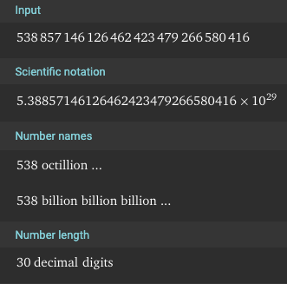
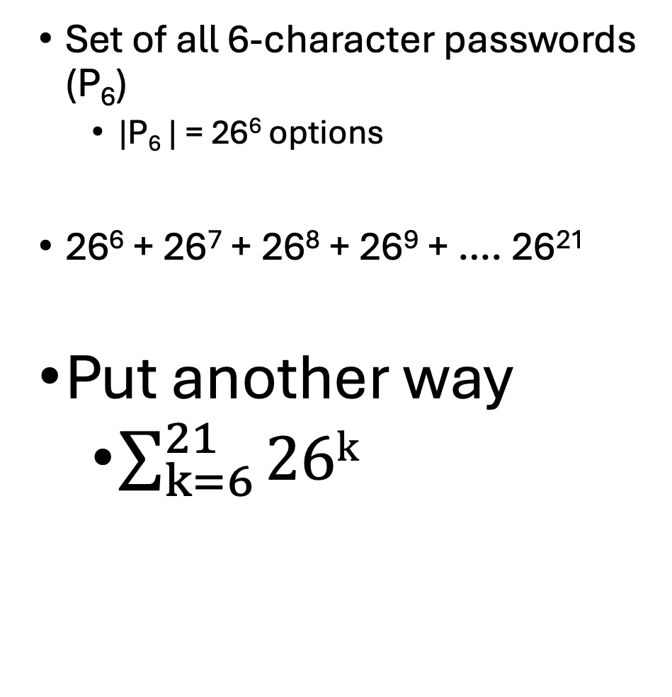
The number of permutations (with repetition)
Set of all 6-character passwords (P₆)
|P₆ | = 26⁶ options
26⁶ + 26⁷ + 26⁸ + 26⁹ + …. 26²¹
Put another way
$\sum_{k=6}^{21}{26k}$

Slide 69
100 passwords a second means
We divide our original number by 100
5388571461264624234792665804.16 seconds
Over 1 quintillion years
The universe is 13.79 billion years old
(according to Wikipedia)
…a while

Slide 70
This is a preview
Computers are good at trying things very quickly
100 passwords a second is probably much too slow for the reality of modern day computers
But when input gets large enough
We run into runtimes that extend beyond the age of mountains
…ideally we find workarounds to improve our speed a bit
What are some ways we could optimize our algorithm
Rather than just trying every possible combo of letters

